Slide 1
Multi-Level Self-Organization in
Cyber-Physical-Social Systems:
Smart Home Cleaning Scenario
7th CIRP IPSS Conference:
Industry Transformation for Sustainability and Business
May 21-22, 2015, Saint-Etienne, France
Alexander Smirnov, Alexey Kashevnik, Andrew Ponomarev
Computer Aided Integrated Systems Laboratory
St. Petersburg Institute for Informatics and Automation
of the Russian Academy of Sciences (SPIIRAS)
International Laboratory on Intelligent Technologies for
Socio-Cyber-Physical Systems
ITMO University

Slide 2
Table of Contents
Introduction
Cyber-Physical-Social Systems (CPSS)
Resources Interaction in CPSS
Multi-Level Self-Organization Approach
Smart Home Cleaning Scenario
  Description
  Participant Ontologies
  Participants Interaction Model
Conclusion

Slide 3









Introduction:
CAIS Lab projects & grants (2007-2015)
Ministry of Education & Science, Russia
Russian Academy of Sciences
  6 projects
Russian Basic Research Foundation
Russian Humanitarian Scientific Foundation
4 projects
1 grant
1 grant
FP6 IST – 1 project (IP “ILIPT”)
ENPI-Finland - 1 project
26 grants
The Swedish Foundation for International Cooperation in Research and Higher Education
5 projects
1 grant
10 projects
2 grants
2 grants

Slide 4
Introduction:
ITMO University
St.Petersburg National Research University of Information Technologies, Mechanics and Optics, more than 10000 full-time students; about 1000 lectures (700 PhD)
Established in 1900
In 2013 the University won a Russian contest among the Leading World Research & Educational Centres (only 15 universities were selected, now – 14 universities).
The University includes 15 Faculties, 3 Institutes, 7 Research Institutes, 49 International Laboratories (ILabs):
  Prof. Alexander Smirnov – a head of International Laboratory (Ilab) on Intelligent Technologies for Socio-Cyber-Physical Systems (March, 2014)
  The Ilab staff: Prof., Dr.habil (2); PhD (6); PhD students (4); Master students (13)
Ministry of Education & Science, Russia
Russian Basic Research Foundation
1 project
2 grants

Slide 5





Introduction: ILab on Intelligent Technologies for Socio-Cyber-Physical Systems
Doing research in the area of social cyber-physical systems, which tightly integrate human users, cyber (IT) systems, and physical systems (real world objects) in real time.
Supervising PhD and master students during work on their theses in the areas of Business Informatics and Applied Informatics of the program Information Systems in Business Process Management.
Carrying out joint educational programs with the Rostock University (one program per year) including summer term for Information Systems & Business Informatics students starting in 2015/2016.
Partners:
Ford Research & Adv. Engineering

Slide 6
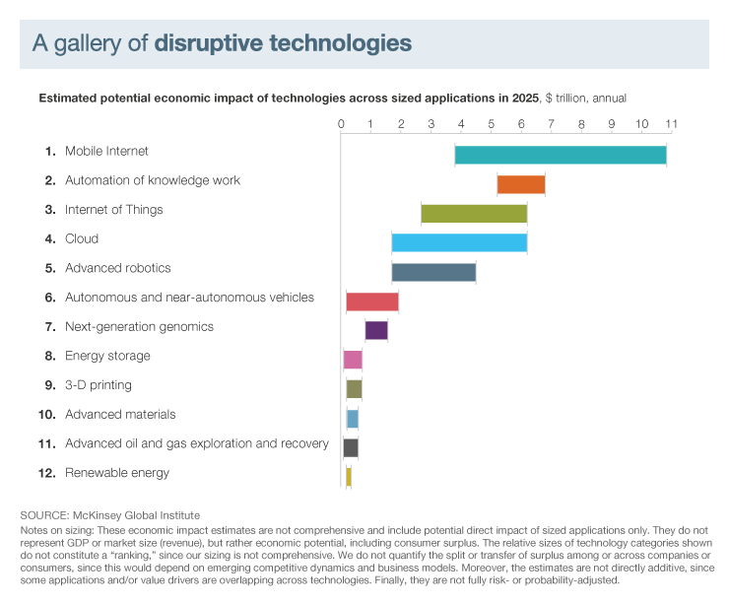
Introduction: Top 12 technologies by McKinsey Global Institute (May 2013)
Source: Report MGI “Disruptive technologies: Advances that will transform life, business, and the global economy” (May 2013)
http://www.mckinsey.com/insights/business_technology/disruptive_technologies

Slide 7

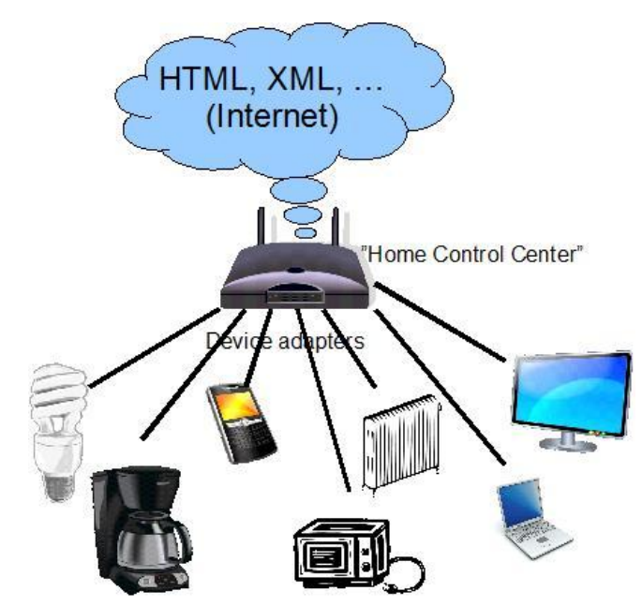

Introduction:
Research Motivation
Increasing number of devices with built-in processors and data storage possibilities (more than 50 billions of devices, more than
5 billions of smartphones will be available in 10 years).
Device interaction technologies which allows to achieve maximum profit: Internet of Things (IoT), World Wide Sensor Network, Smart Building Environment, and etc.
Limitation of cognitive human abilities, which progress slowly than computers (usually at the moment human can not keep in mind all information he/she need for making decisions).

Slide 8
Cyber-Physical-Social Systems:
Cyber-Physical Systems Definitions
Cyber-physical systems (CPS) are physical and engineered systems whose operations are integrated, monitored, and/or controlled by a computational core. Components are networked at every scale. Computing is deeply embedded into every physical component, possibly even into materials. The computational core is an embedded system, usually demands real-time response, and is most often distributed.
Helen Gill, NSF, USA
Cyber-Physical Systems or “smart” systems are co-engineered interacting networks of physical and computational components. These systems will provide the foundation of our critical infrastructure, form the basis of emerging and future smart services, and improve our quality of life in many areas.
National Institute of Standards and Technology, USA

Slide 9
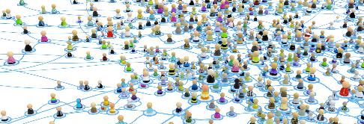
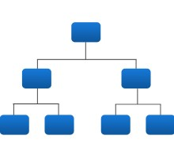



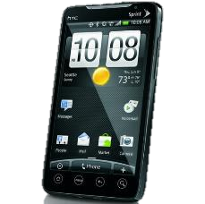
Cyber-Physical-Social Systems:
Main Components
CPSS in contrast with CPS consist of not only cyberspace and physical space, but also human knowledge, mental capabilities, and sociocultural elements.
Social Networks
Physical world
Cyber-Physical-Social Systems
IT world

Slide 10
Cyber-Physical-Social Systems:
Difference between CPS and CPSS
People
Social space
Interacted devices
Cyber space
Cyber-Physical-Social Systems
Cyber-Physical Systems
Physical devices
Physical space

Slide 11
Resources Interaction in CPSS:
Ontology Usage
An ontology, is a domain vocabulary complete with a set of precise definitions, or axioms, that constrain the meanings of the terms sufficiently to enable consistent interpretation of the data that use that vocabulary.
Ontology is a formalization of problem domain in terms understandable by computational devices and recources.
Ontology supports semantic interoperability between interacted recources.

Slide 12
Resources Interaction in CPSS:
Ontology-Based Approach
Ontology₁
Resource₁
Service₁
CPSS
Smart Space Ontology Library
Ontology Matching Service
Service₂
Ontology₂
Resource₂

Slide 13
Multi-Level Self-Organization Approach: Principles
Enables a more efficient self-organisation based on the “top-to-bottom” configuration principle, which assumes conceptual configuration followed by parametric configuration.
Principles:
  self-management and responsibility,
  decentralization, as well as integration of chain policy transfer (a formal chain of policies running from top to bottom) with network organisation (without any social hierarchy of command and control within a level),
  initiative from an upper level and co-operation within one level.
The idea can be interpreted as producing “guided order from noise”.
Reference: Smirnov, A., Sandkuhl K., Shilov N. in “Multilevel Self-Organisation of Cyber-Physical Networks: Synergic Approach”. Int. J. Integrated Supply Management, 8 (1/2/3),
90–106 (2013).

Slide 14
Multi-Level Self-Organization Approach:
Generic Scheme
3. Strategic level
Higher level
Policy
2. Planning level
Lower level
Policy
New knowledge,
norms, guiding
1. Physical level
Self-contextualization
Environment
Self-management
Activity
Subjective (contextualized) knowledge
Intra-level relationships
Inter-level guiding

Slide 15
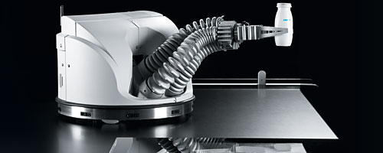
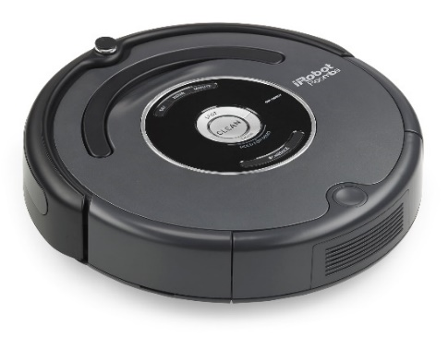
Smart Home Cleaning Scenario:
Description
Recources:
  Strategic planning service determines the general
  strategy of resources behavior in the scenario.
  Personal mobile devices accumulates people
  preferences and desires.
  Room management services are services of planning level that organize the general behavior of resources in physical level.
  Physical devices (Robot vacuum cleaners, Manipulating robots, illumination control, information network, …).

Slide 16


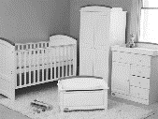


Smart Home Cleaning Scenario:
Three Levels of Resources
Strategic Level
Strategic Planning Service
Personal Mobile Device
Room 1 Management Service
Room 2 Management Service
Room n Management Service
Planning Level
Robot Vacuum Cleaner
Manipulating Robot
Light Control
Physical Level
- movement and cleaning
- building room map
- photosensitive sensor
- movement
- transport furniture
- changing light intensity

Slide 17
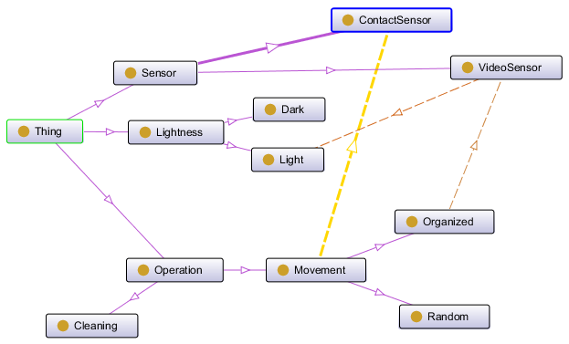
Smart Home Cleaning Scenario:
Vacuum Cleaner Robot Ontology
is_a
is_a
is_a
is_a
Required
is_a
Required
is_a
Required
is_a
is_a
is_a
is_a
is_a

Slide 18
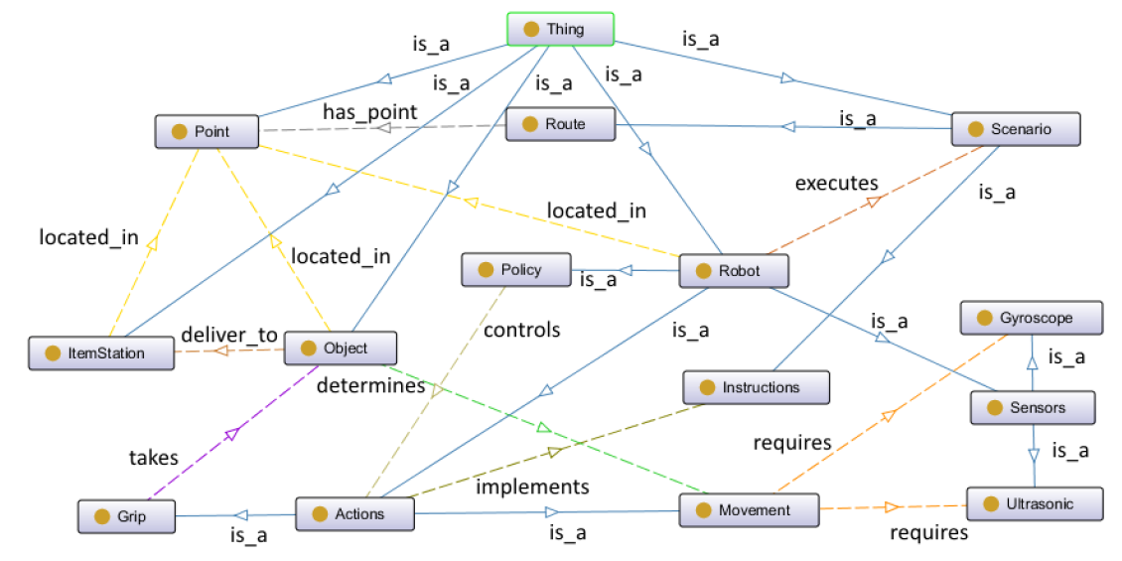
Smart Home Cleaning Scenario:
Manipulating Robot Ontology

Slide 19
Smart Home Cleaning Scenario:
Two Simplified Scenarios
Robots Interaction Scenario
  Two or more robots receive a task to execute actions, e.g. find an object and bring it to a storage.
  Only one robot should handle this task.
  Robots should interact to find the one who will bring the object to the storage.
Pick-and-Place Scenario
  The system solves the task of pick-and-place an object from one point to another.
  Two types of robots participate in the system scenario.
    - Pipeline robot (can scan object’s characteristics, can provide the object to the end of pipeline).
    - Manipulating robot (can take the object and move it to another place based on object’s characteristics).

Slide 20
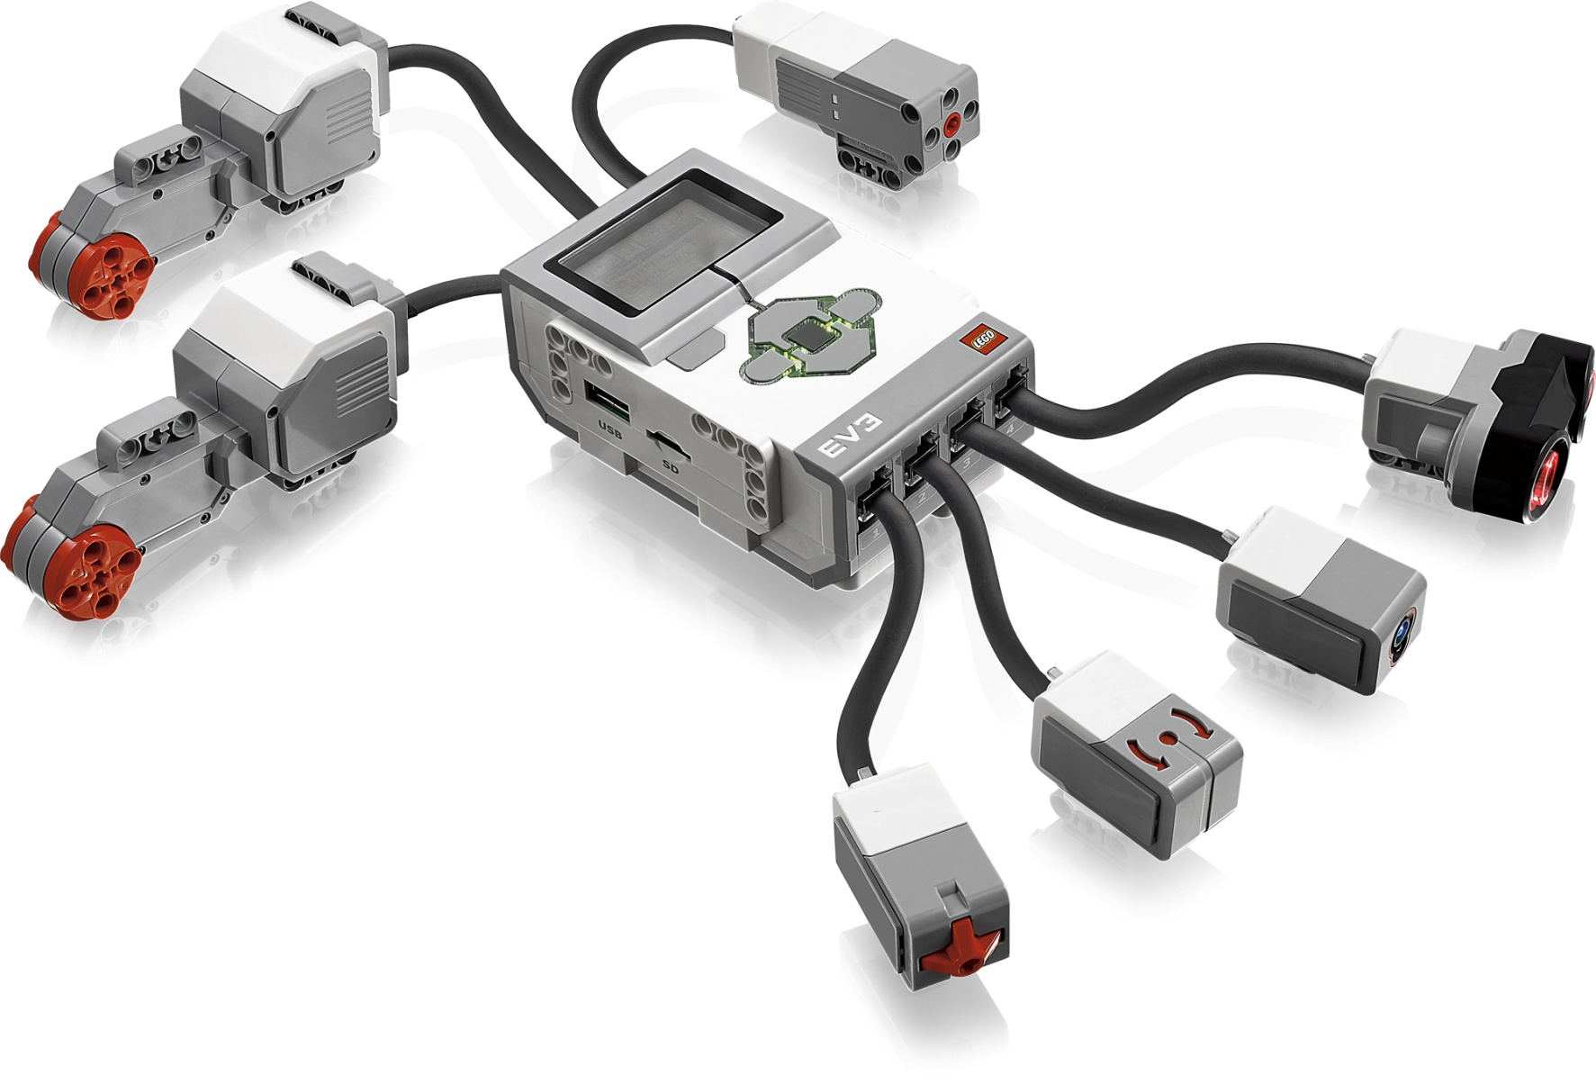
Smart Home Cleaning Scenario:
Lego® Mindstorms EV3 Kit
Medium motor
Ultrasonic sensor
Large motor
Main block
Large motor
Color sensor
Touch sensor
Gyroscopic sensor

Slide 21
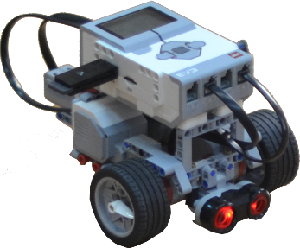
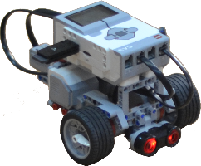
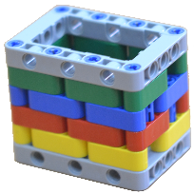
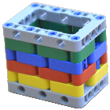
Smart Home Cleaning Scenario:
Lego Robots Interaction Scenario Live Demo
Cyber Space
Robot 1:
30 cm = 30 cm => It’s another robot.
40 cm – distance to object.
40 cm < 50 cm => I have to go to object
Robot 2:
30 cm = 30 cm => It’s another robot.
50 cm – distance to object.
50 cm > 40 cm => I have to stay here
40 cm
30 cm
30 cm
50 cm

Slide 22
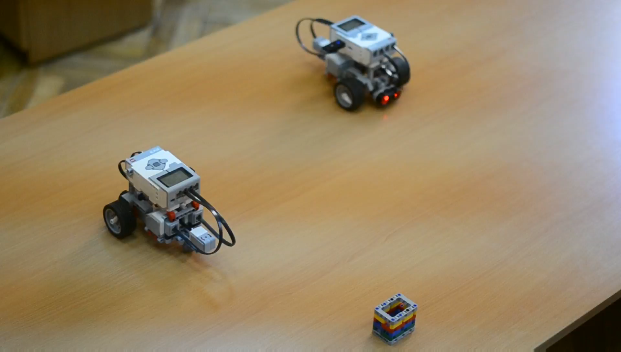

Slide 23
Conclusion and Future Work
The paper propose ontology based multi-level self-organization approach for cyber-physical-social systems operation.
There are three levels for cyber-physical-social system have been identified: strategic level, planning level, and physical level.
Presented in the paper approach allows to extend available at the moment in the market cleaning robots by the smart services that implement optimization of robots behaviour and increase quality of operation.
Approach has been prototyping through the two simplified scenarios developed based on Lego Mindstroms EV3 kits.
For the future work it is planned to join best parts of developed scenarios for implementing it based on accessible in the market cleaning robots.

Slide 24

Thank you!!!
Prof. Alexander SMIRNOV, St. Petersburg, Russia,
E-mail: smir@iias.spb.su

